Slide 1
Prostate Cancer Detection using Deep Convolutional Neural Networks
Sara Khosravi
2021

Slide 2
Overview
Published in 2019 in nature
Cited 55 times
Written by biomedical researchers (mainly) from university of Toronto
Some authors research domain is medical not CS.

Slide 3
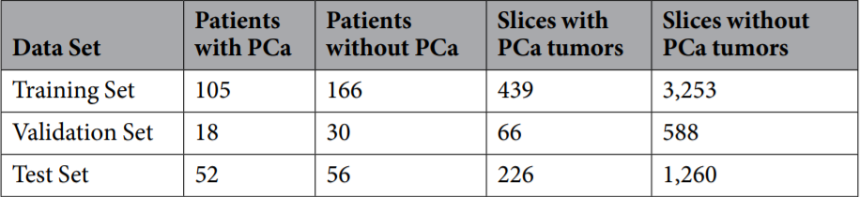
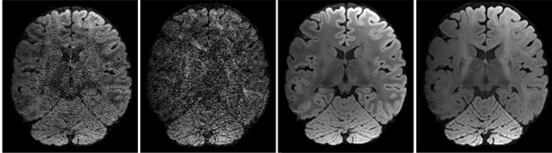
Dataset
axial DWI images: 5,832 2D slices
Larger dataset than previous same works
Available if requested
427 total patients:
175 patients with prostate cancer(Pca)
319 patient images for train
108 patient images for test
Fig1. Number of patients and slices with and without PCa for training, validation, and test sets
Fig2. Example of Axial DWI image (Not from prostate)

Slide 4
Methods
4

Slide 5
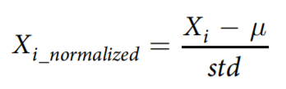
Preprocess
X_i is each 2D slice pixels
The mean and variance are calculated for the whole dataset.
Used automatically center-cropped DWI images instead of feeding regions of interests (ROIs).
No expert is needed

Slide 6
Method: from slice to patient level
Slice level detection: give each 2D DWI slices to 5 CNNs
Slice level classification: stack trained modified Res-Nets (Architecture in slide 9)
Stacked generalization: ensemble technique to train multiple classifiers with the same dataset and makes a final prediction using a combination of individual classifiers’ predictions.
Feature extraction: simple statistical features are extracted with decision tree

Slide 7
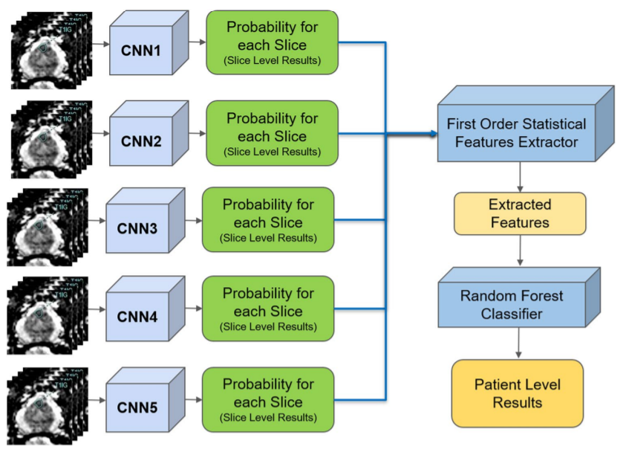
Pipeline
Each 2D slices is given to 5 CNNs (to use ensemble learning in feature extraction).
Input: 144 × 144 pixels, center cropped with 66 × 66 pixels such that the prostate was covered (automatically). Approach is independent of radiologists.
Modified CNNs to feed DWI data with 6 channels (ADC, b0, b100, b400, b1000, and b1600) instead of images with 3 channels (red, green and blue.)
No prior knowledge on the biopsy locations.
Fig3. Pipeline block diagram

Slide 8
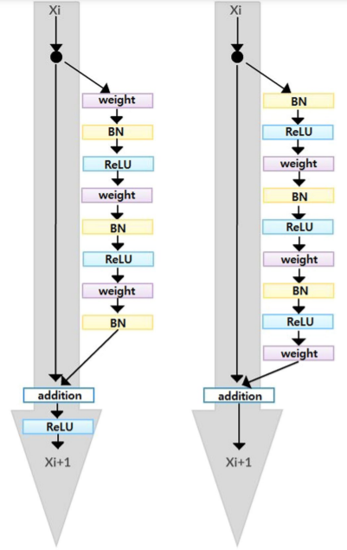


CNNs architecture
Difference with ResNet: batch normalization and ReLU activation layers comes before the convolution layers
Fig4. The structural difference between original residual network and fully pre-activated residual network

Slide 9
Architecture
Slice level classification: A 41 layers deep ResNet (found to be optimal by parameter tuning using validation set)
2D convolutional layers with a 7 × 7 filter followed by a 3 × 3 Max pooling layer and residual blocks
Input images were small (66 × 66 pixels), tumorous regions were even smaller (e.g., 4 × 3 pixels): additional ResNet blocks or deeper networks were needed.
First ResNet Block: 3-layer bottleneck blocks with 2D CNN layers with filter sizes 64, 64 and 256 which is stacked 4 times.
Second ResNet Block: 3-layer bottleneck blocks with 2D CNN layers with filter sizes 128, 128, and 512 which is stacked 9 times.

Slide 10
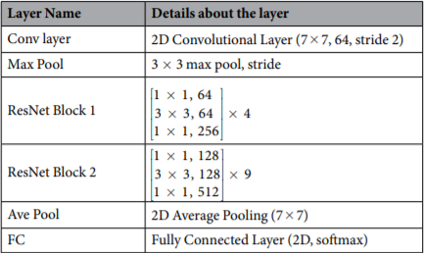
Architecture
Dropout rate: 0.9
Batch size: 8
Initial learning rate: 0.001
Used gradient descent
Initial weights: random
Train each CNN with 100 iterations.
Fig5. Proposed model architecture

Slide 11
PCa feature extraction
Pij: probabilities of a MRI slice associated with Pca Nij: probabilities of a MRI slice associated with non Pca
i: represents one of five individually trained CNNs j: represents each MRI slice of a patient
N: total number of MRI slices for each patient
Each CNN produces two probability sets: P_i = { p_i1 , … p_iN } and N_i = {n_i1, … , n_iN}
Top 5 probabilities which are higher than 0.74 were selected from each P and N sets.
From them, 9 first-order features are extracted: mean, standard deviation, variance, median, sum, minimum (only from non PCa class), maximum (only from PCa class), skewness, kurtosis, and range from the minimum to maximum
From these 9*2*5 = 90 features, 26 most important features are extracted via a decision tree.

Slide 12
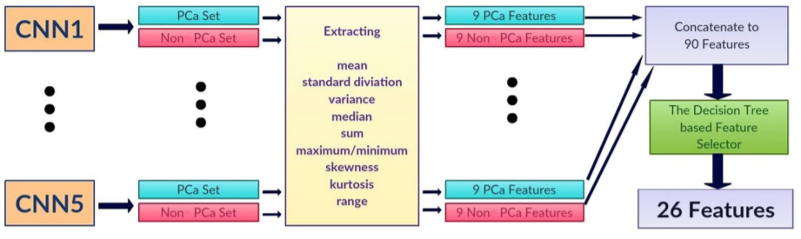
PCa feature extraction
Fig6. Feature extraction

Slide 13
Evaluation

Slide 14
Results
train set: 75% of dataset, 15 % of train set was for validation
Test set: 25% of dataset
Used 10 fold cross validation
Biased dataset:
1) labels are generated by humans
2) People suspicious to have tumor take MRI.

Slide 15
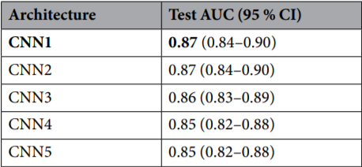
Results
Five different results for each CNN on same slice
Best AUC: 0.87 for CNN1
Fig.7 : Slice-level performances of five individually trained CNNs

Slide 16
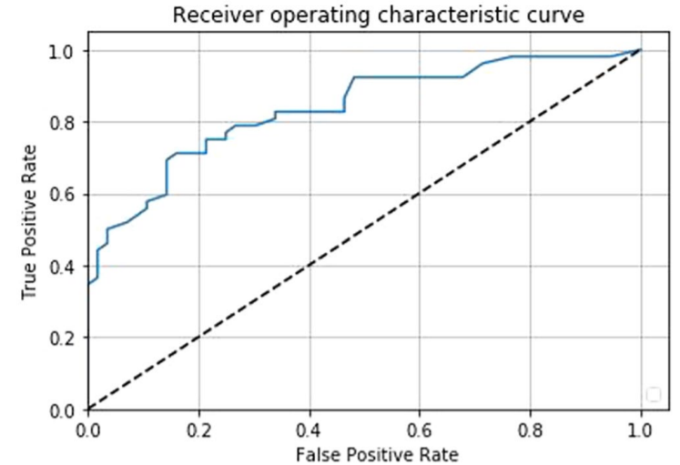
Patient level performance
Patient-level AUC by our Random Forest classifier with the features extracted through CNNs : 0.84
Fig.8 : Patient-level ROC curve of the proposed pipeline

Slide 17
Thanks For Your Attention
Any Questions?
Contact: srkhsrv21@gmail.com

Slide 18
Resources
Prostate Cancer Detection using Deep Convolutional Neural Networks

